Slide 1
City of Sebastian
Comprehensive Development Plan 2040
Livability Workshop
February 20, 2020
Preserving Our Past ~ Preparing For Our Future
Infrastructure
Land Use
Environment

Slide 2
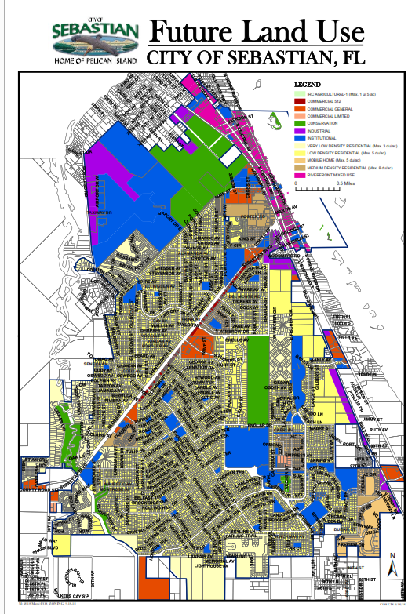

PURPOSE OF WORKSHOP
High Level Concepts
Plan Format
What do you love about your community? What does “small town” mean to you?
What smart growth changes are needed in the future – land use, housing, mobility – to sustain the livability of your community?
What would you consider priority issues?
Notes:
Need the “top 3” Topics for the Survey
keep in mind – difference between Topic and Value
AND also, are these broad (City-wide) or specific (neighborhoods)
specific items should be addressed with NH Workshops

Slide 3
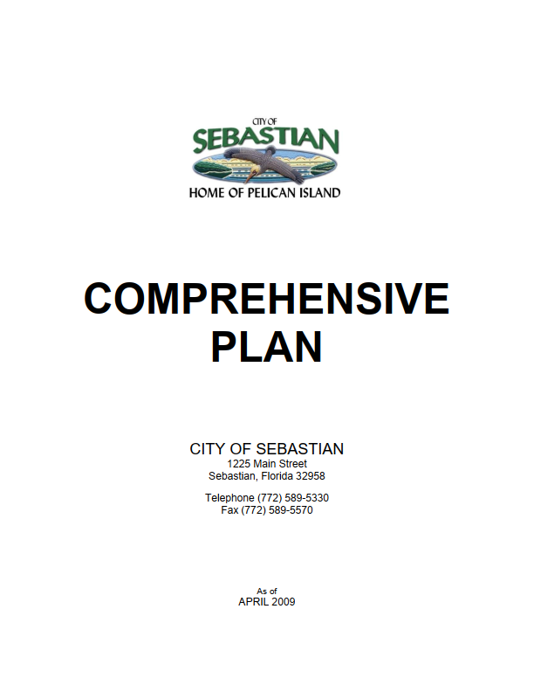
A. Color and Design

Slide 4
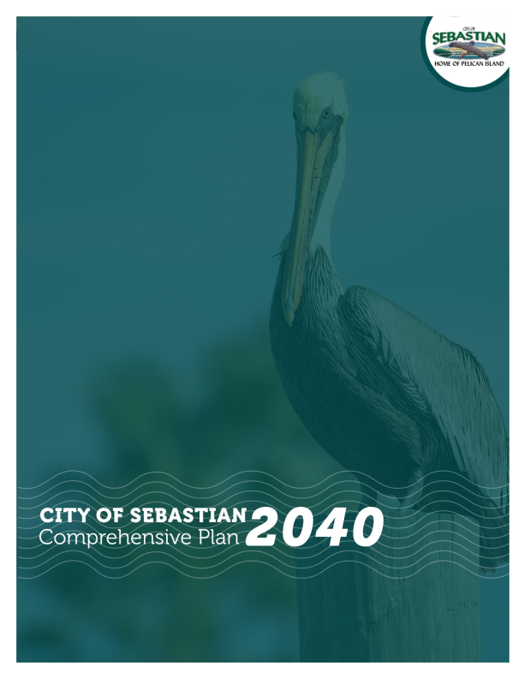
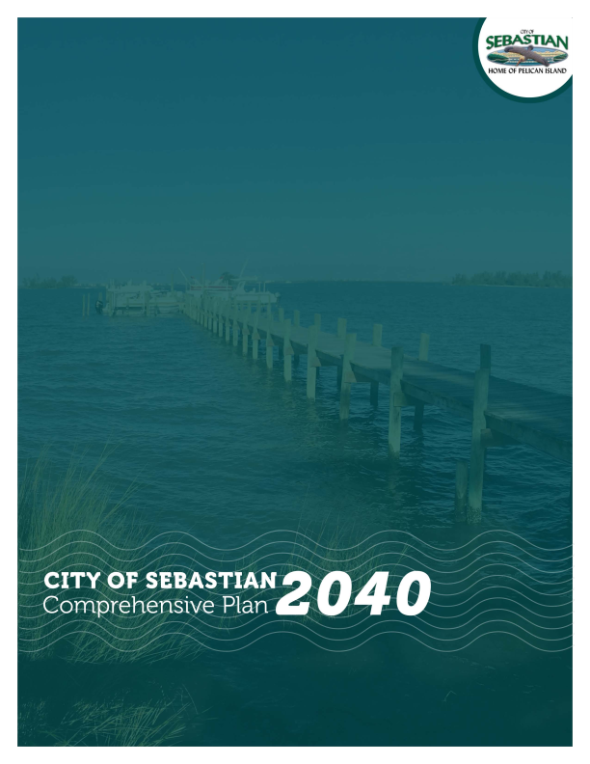

Slide 5

B. Document Layout
ELEMENTS
Existing consists of Eleven Elements:
FLU, Transportation, Housing, Public Facilities, Coastal Management, Conservation, Recreation and Open Space, Intergovernmental Coordination, Capital Improvements, General Monitoring, Public School Facilities
Future will consist of Eight Elements:
FLU, Transportation & Mobility, Housing, Infrastructure, Conservation & Coastal Management, Recreation & Open Space, Governance& Implementation, Public Schools
2. DOCUMENT LAYOUT
Existing: DIA and maps in front, GOPS behind
Future: GOPS in front, DIA to follow
Suggested Additions:
Executive Summary
Introduction
Acronyms & Definitions
Index & Reference Tables
Map Series
Elements

Slide 6
HIGH LEVEL CONCEPTS AND DEFINITION
Livability and Smart Growth Principles are planning concepts with substantial overlap and may be used interchangeably.
Livability is a high-level performance measure of factors that are critical to high quality of life for people of all ages. (AARP)
Smart Growth Principles is a theory of land development that accepts that growth and development will continue to occur and so seeks to direct that growth in an intentional, comprehensive way. (Ten Principles)
Urban Sprawl means a development pattern characterized by low density, automobile-dependent development with either a single use or multiple uses that are not functionally related, requiring the extension of public facilities and services in an inefficient manner, and failing to provide a clear separation between urban and rural uses.(F.S. 163)

Slide 7
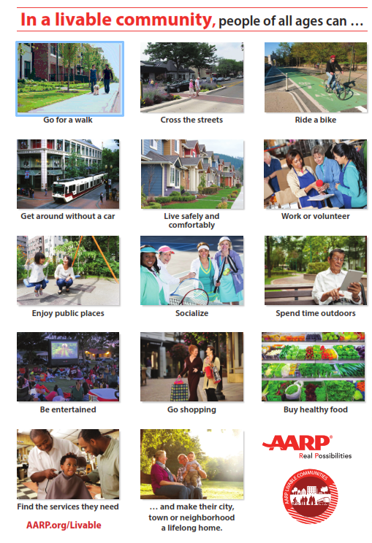
Livability features that benefit everyone
1. COMPACTNESS helps make a community walkable, decreases automobile dependence and supports a socially vibrant public realm
2. INTEGRATION OF LAND USES enables people to live closer to or within walking distance of work, community activities and the services they need
3. HOUSING DIVERSITY helps ensure that suitable housing is available for each stage of life
4. TRANSPORTATION OPTIONS allow older adults to remain independent, mobile and engaged in their community

Slide 8
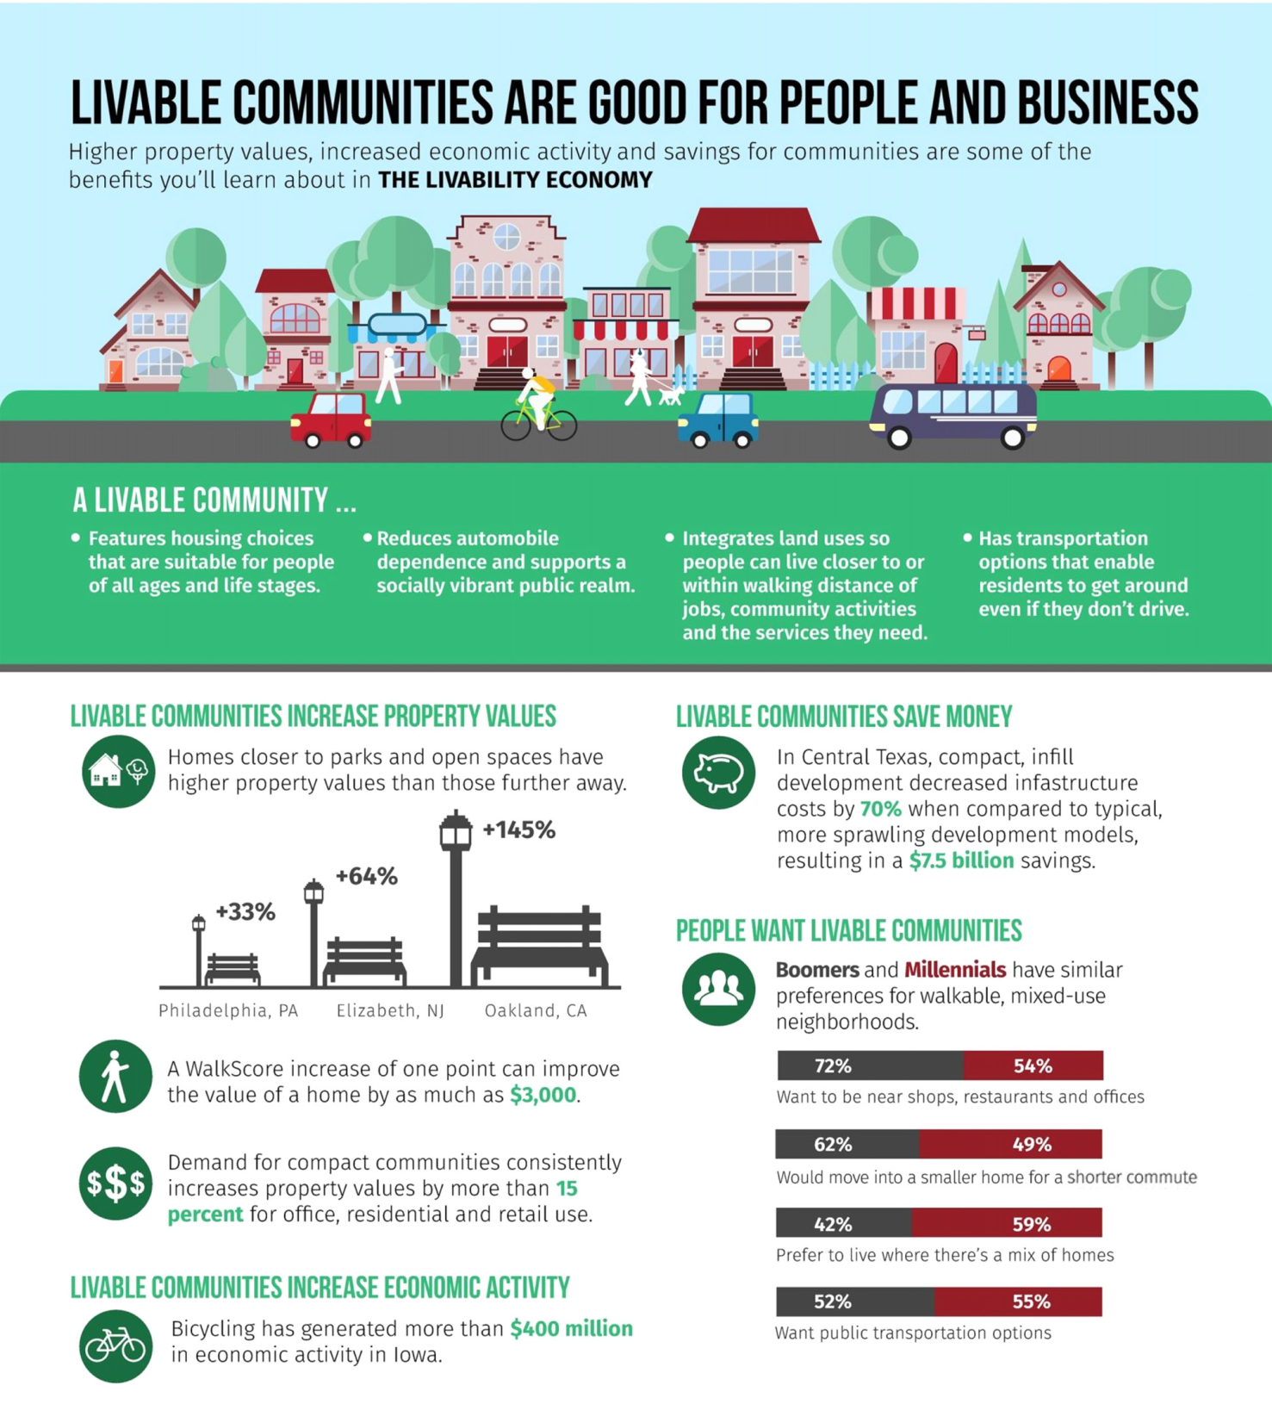

Slide 9
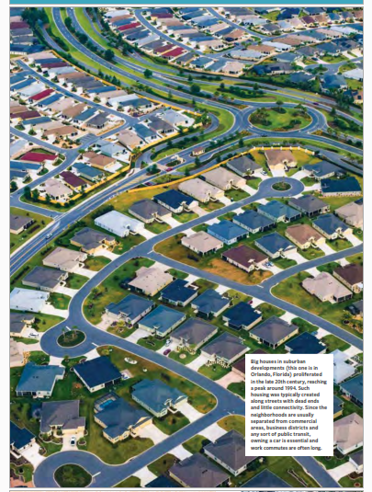
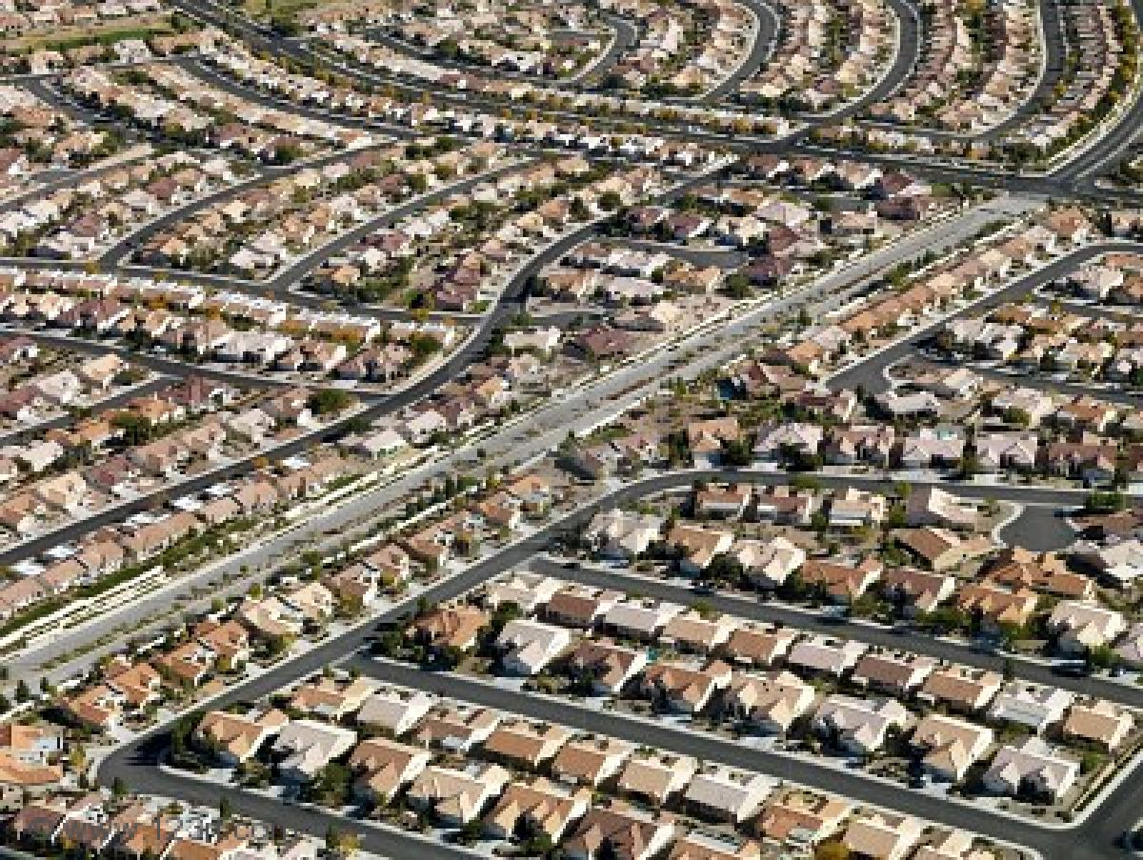
THIS IS SPRAWL

Slide 10
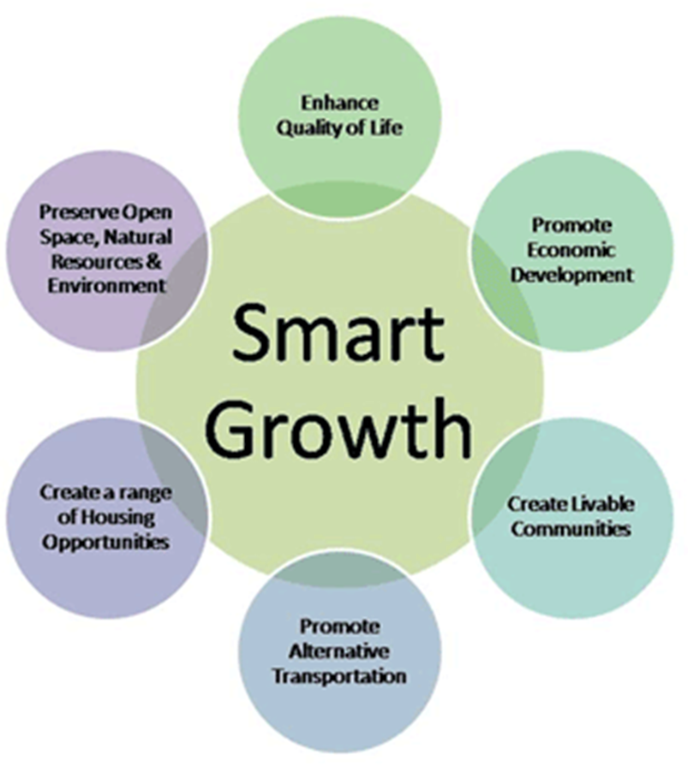
Ten Principles of Smart Growth
Mix
Mix land uses.
Take
Take advantage of compact building design.
Create
Create a range of housing opportunities and choices.
Create
Create walkable neighborhoods.
Foster
Foster distinctive, attractive communities with a strong sense of place.
Preserve
Preserve open space, farmland, natural beauty, and critical environmental areas.
Strengthen and direct
Strengthen and direct development towards existing communities.
Provide
Provide a variety of transportation choices, urban and social infrastructure based on population projections.
Make
Make development decisions predictable, fair, and cost effective.
Encourage
Encourage community and stakeholder collaboration in development decisions.

Slide 11
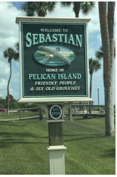
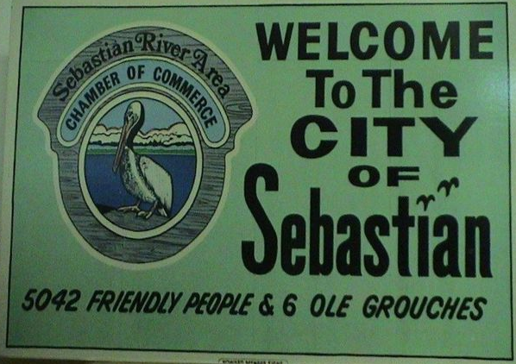

Slide 12
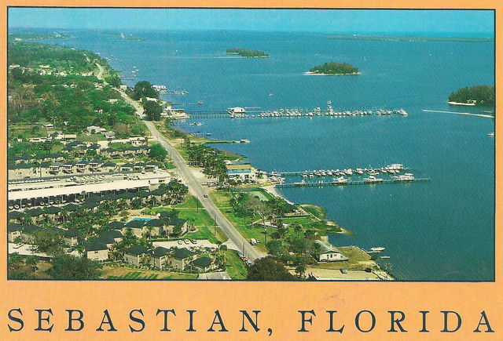

Slide 13
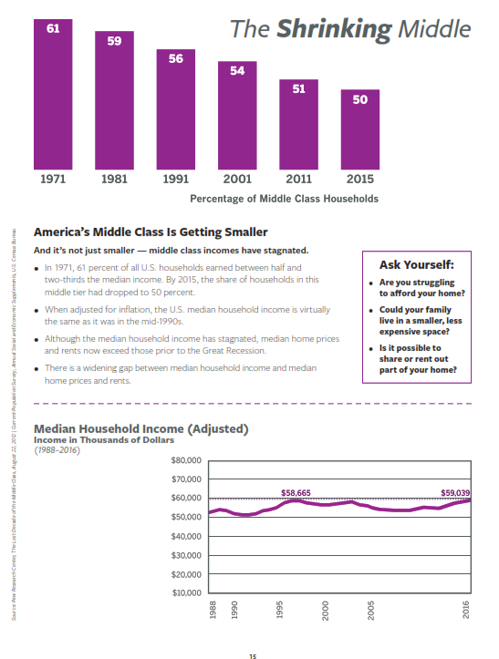
22%of Americans will be age 65 or older in 2050
32%of young adults live at home
48%of adults are single
27%of children live with a single parent
11%fewer American households were middleclass in 2015 than in 1971

Slide 14
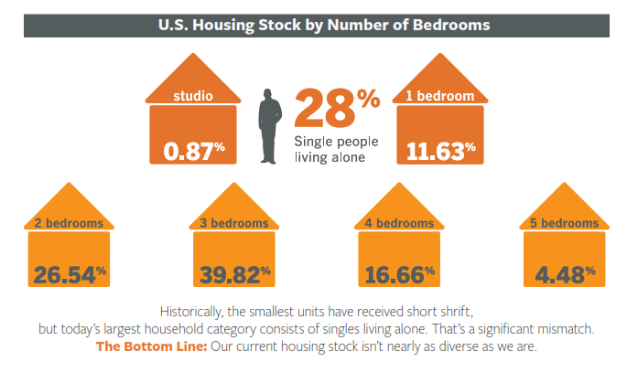

Slide 15
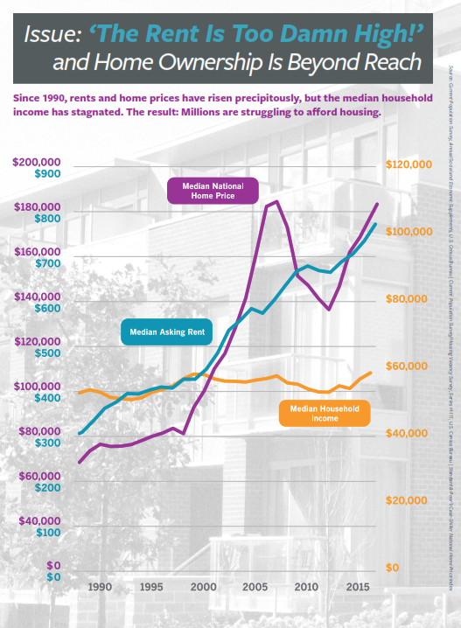

Slide 16
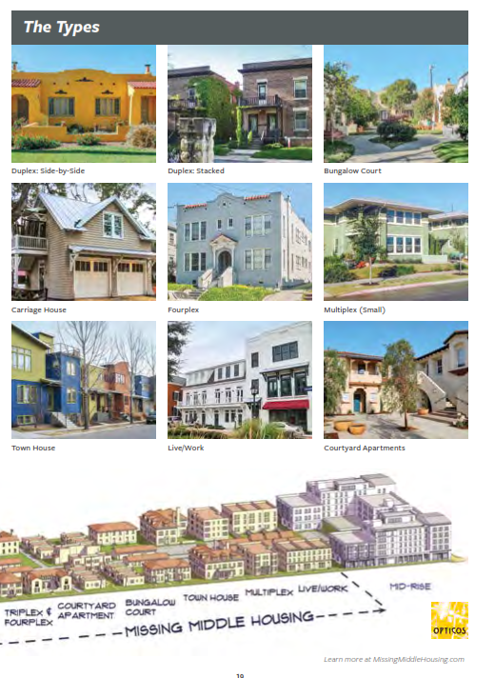
Missing Middle Housing is a range of multi-unit or clustered housing types—compatible in scale with detached single-family homes—that help meet the growing demand for walkable urban living.

Slide 17

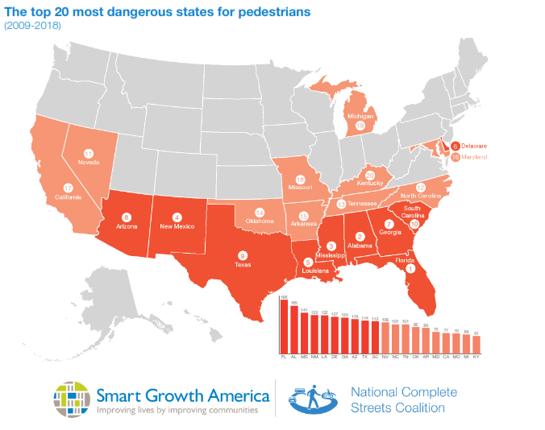

Slide 18
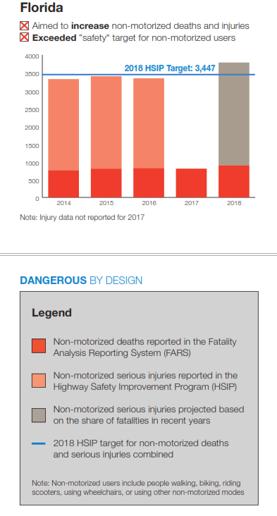
2018 was the deadliest on record for people walking and riding bicycles in nearly three decades.
In 2018, drivers in the United States struck and killed 6,283 people walking, and another 857 people were struck and killed while riding bicycles.
Between 2009 and 2018, traffic deaths among motor vehicle occupants declined by one percent, but over the same decade traffic deaths among people walking increased by 53 percent.
Similarly, traffic deaths among people bicycling increased by 36 percent during this time period.

Slide 19
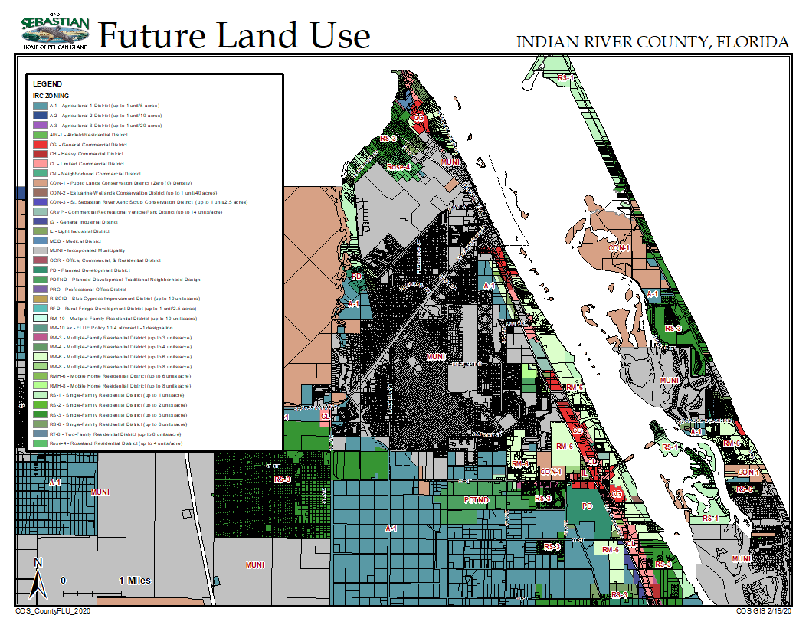

Slide 20



City Stats
2020 Population 25,957
Persons 65+ 31.6%
MHI $49,655
Poverty 12.6%
Home Ownership 80.2%
Median Housing Rent $1,139
Median Housing Value $199,563
Housing Type SF >87%

Slide 21
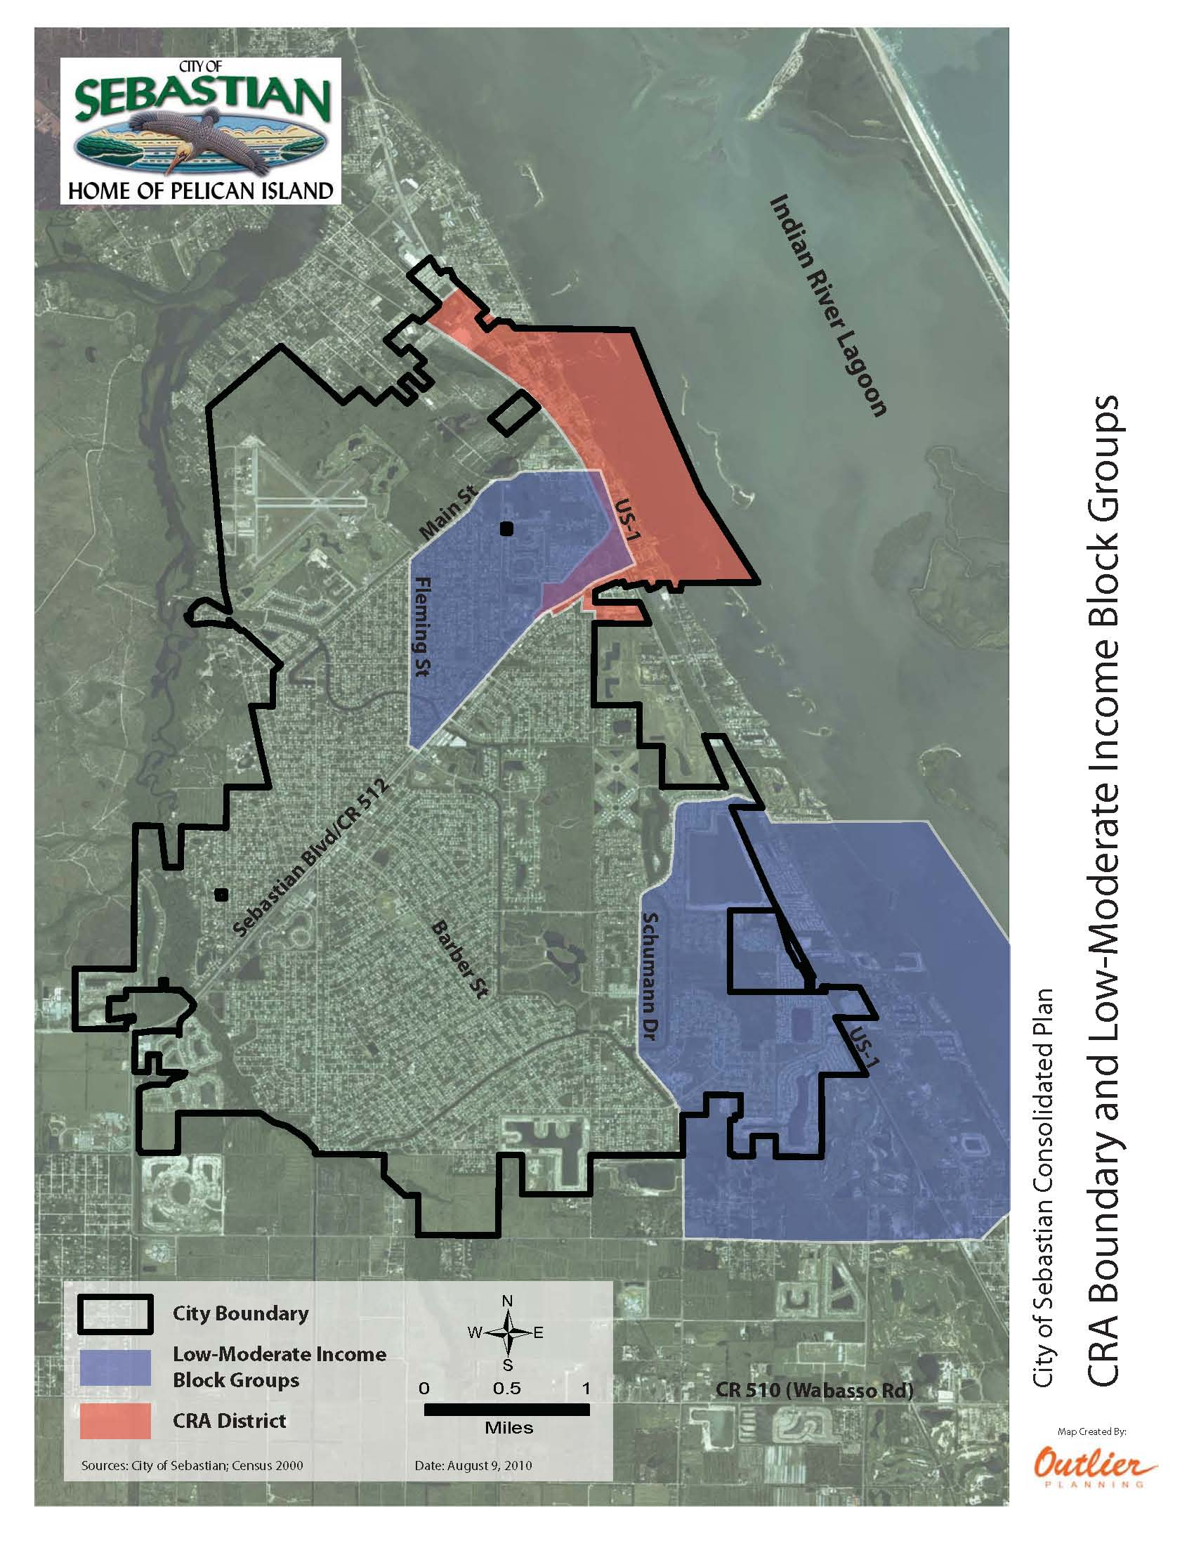




2000 CDBG Census Tracts
51% of IRC households struggle to pay for basic necessities food, housing and childcare
Average Florida resident needs greater than $22/hr to meet basic necessities of housing, food, transportation

Slide 22
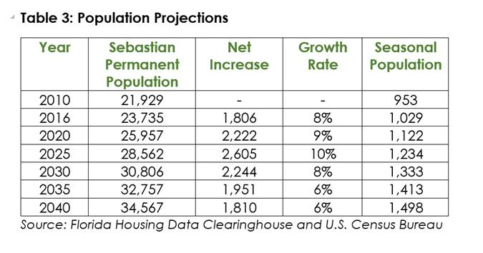

Slide 23
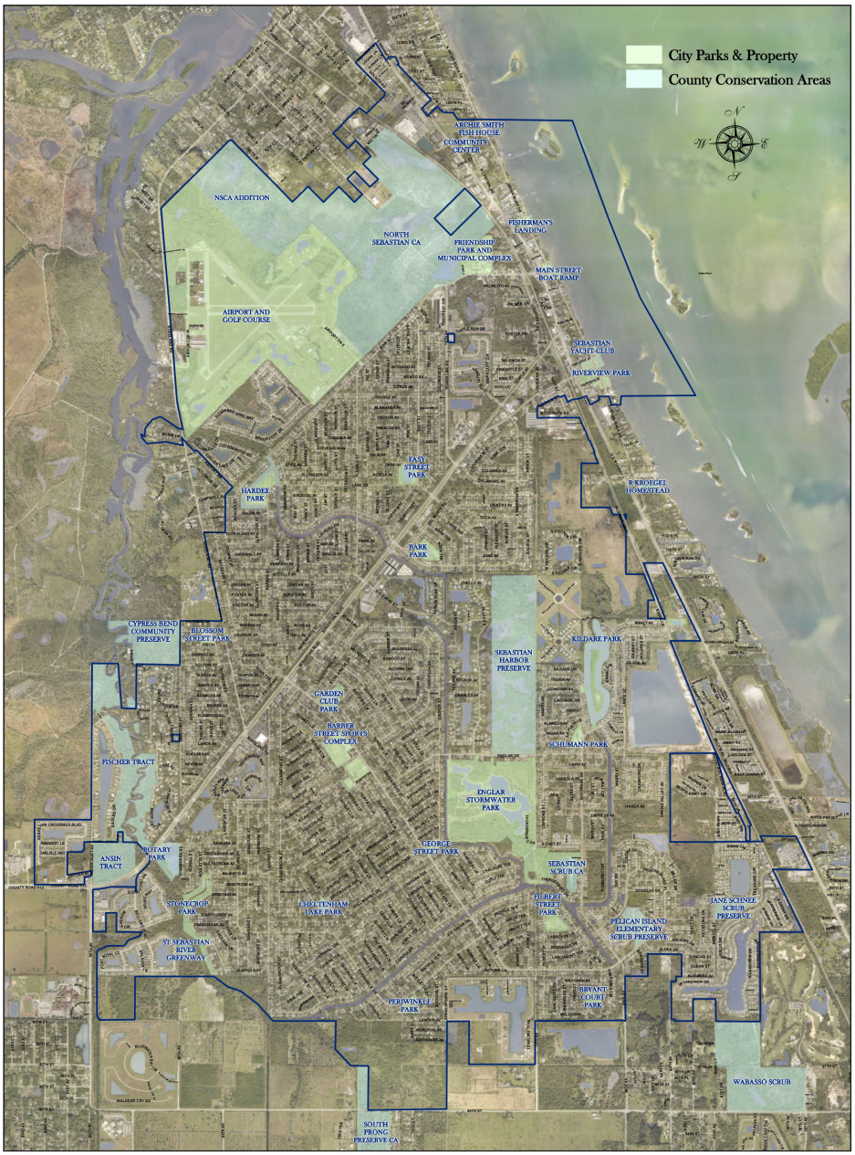
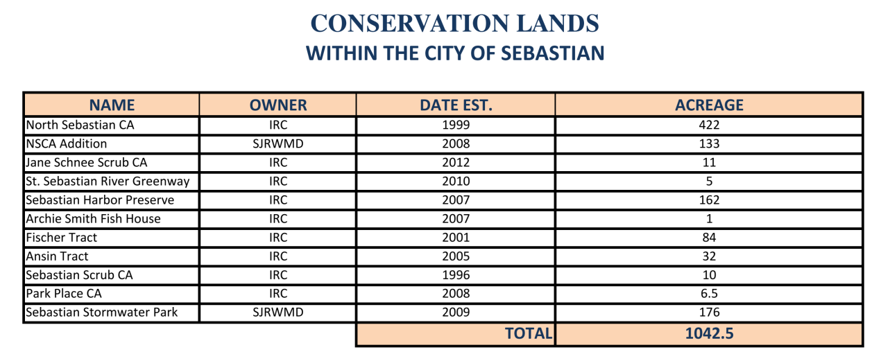
+/- 400 acre parks
>15% of land area
COS GIS 8/8/19
COS GIS 4/30/18

Slide 24
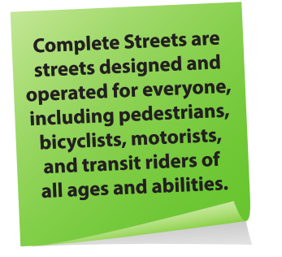
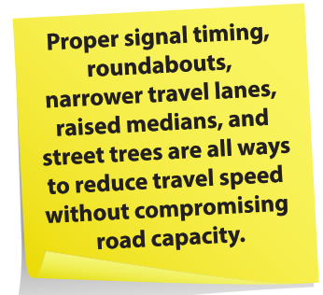
Food for Thought
Plan for increased density in centers and along corridors
Encourage mix of uses in development/redevelopment
Facilitate infill development and retrofitting of suburban neighborhoods
Provide for alternate modes of transportation in a walkable environment
Preserve open space for natural resource enhancement
Create vibrant civic spaces in urban areas
Provide shared parking reductions and mixed-use development incentives
Complete missing sidewalk connections around transit corridors
Provide bicycle parking and service stations at major transit centers
Plan for climate change as it affects the location of infrastructure and land use patterns
Adopt Pedestrian and street connectivity standards
Improve the vitality of mixed-use neighborhood-serving commercial centers through increased density allowance and enhanced design
Conduct land use and market analyses to identify sites within expansive residential areas that could support new or expanded neighborhood commercial centers.
Identify potential bike & pedestrian connections between residential and commercial areas.
Adopt ‘complete streets’ policies
Improve community access to transit
Develop and expand the use of accessory dwelling units to provide affordable housing options

Slide 25
DISCUSSION TOPICS
What do you love about your community?
What does “small town” mean to you?
What smart growth changes are needed in the future – land use, housing, mobility – to sustain the livability of your community?
What would you consider priority issues?

Slide 26
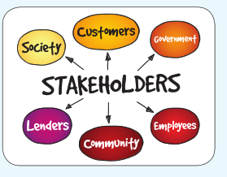
Proposed Timeline
NRB Cons/Coastal: March 3, 2020
LPA FLU, Housing, Schools: March 19, 2020
LPA Mobility, Facilities: April 16, 2020
P&R Parks, Rec, Open Space: April 27, 2020
LPA Parks/CC: May 21, 2020
LPA Final Draft: July 16 or Aug 6
CC Final Proposed: Aug 26 or Sept 9

